Slide 1

Making Successful host for Listings123)

Slide 2
Generating more revenue for the company
Funding the nationwide campaign created by the marketing team in order to expand the company in new cities.
Collaborating with the marketing team, we managed to explore and manipulate the current data, find traits in our database, which shows excellent potentials of expanding the project in to new cities.
Pseudo-Revenue, which is a reflection on the company revenue, is highly affected by the average of days listed, average price and number of reviews.
Super strict cancellation policy has a negative effect on revenue. Having less strict cancellation policy will make more guests interested in the accommodation listed.
San Francisco is making the largest portion of the Pseudo-Revenue, increasing the number of host in San Francisco will generate more revenue for the company.

Slide 3
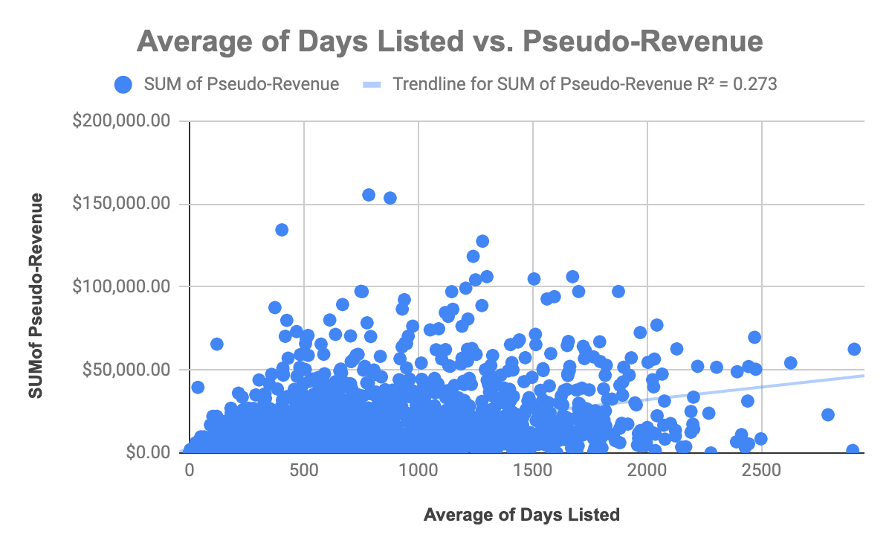
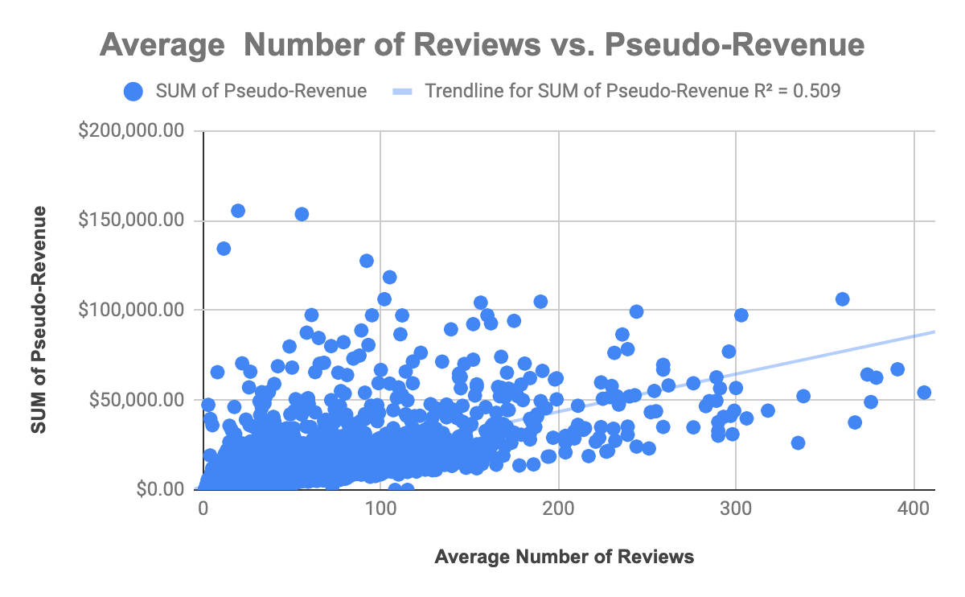
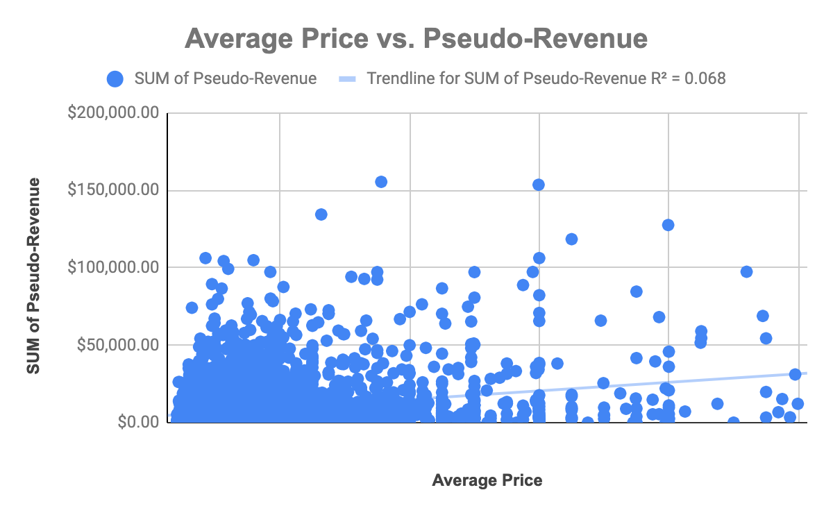
How to increase the Pseudo-Revenue
Pseudo-Revenue has a strong relationship with: - Average of days listed, most days listed are in the lower side (between 0 and 1) increasing the average of day listed will increase the Pseudo-Revenue.
- Average of number of reviews, number of reviews are close to 1 increasing it, will increase the Pseudo-Revenue.
- Average price, the average price is close to $100 increasing the average price will increase the Pseudo-Revenue.

Slide 4
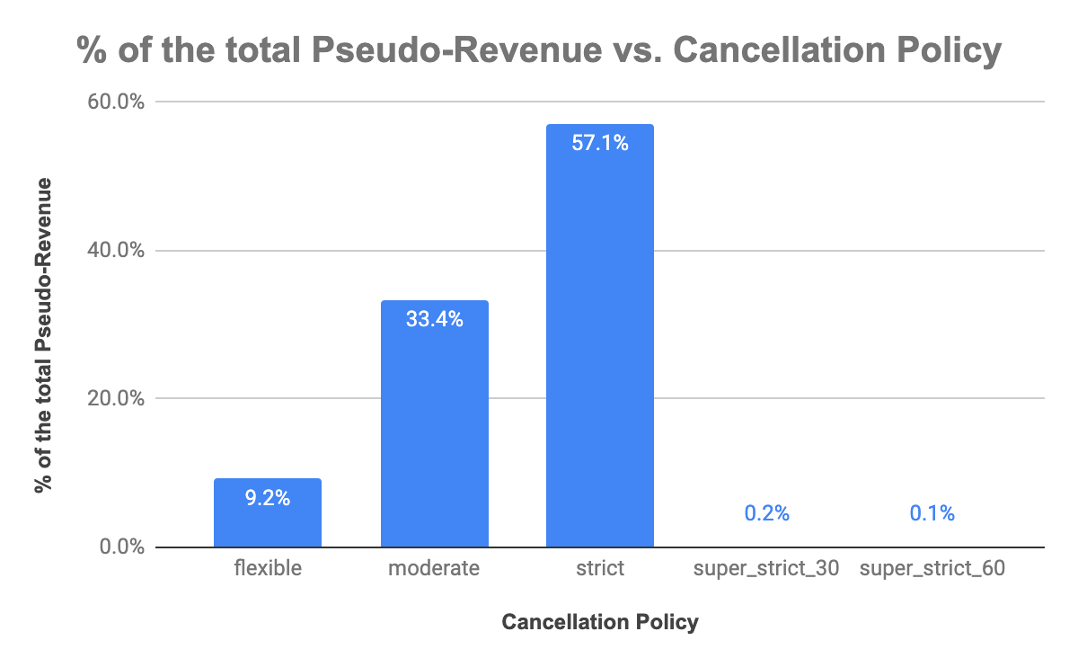
The effect of the cancellation policy in the Pseudo-Revenue
Flexible cancellation policy represent 9.2% of the total Pseudo-Revenue, which increase to 33.4% in the moderate cancellation policy and reaches 57.1% of the total Pseudo-Revenue in the strict cancellation policy.
Super_strict_30 and super_strict_60 represent only 0.2% and 0.1% of the total Pseudo-Revenue.
The more restricted the cancellation policy the less Pseudo-Revenue was generate. Having the policy between the moderate and strict policy will generate more Pseudo-Revenue.

Slide 5
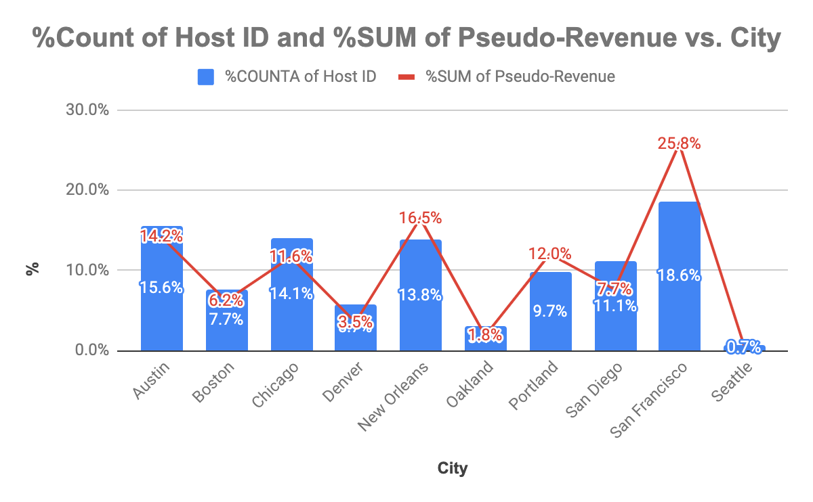
San Francisco with the most host and the most revenue
The company has listing accommodation in 9 cities.
San Francisco is making the largest portion of the Pseudo-Revenue which is 25.8% of the total Pseudo-Revenue by having the most Host ID count which is 18.6% of the total Host ID count, while Seattle is making the lowest portion of the Pseudo-Revenue, which is 0.6% of the total and has the lowest Host ID count of 0.7% of the total.
Increasing number of host In San Francisco will increase the Pseudo-Revenue for the company.
(Insert Visual Here)
0.6%

Slide 6
How to achieve our goals
Having the marketing campaign funded by investors and venture capital :
- Will help the marketing campaign creating the nationwide campaign, which will increase number of hosts and provide them with the guidance to attract more guests and expand in more cities, that will be of a great revenue for the company, investors and venture capital.
-Will help in collecting more data about new cities, and their demand for temporary accommodation. Doing that will help in creating a study about the market demand and having a plan for a successful future expansion of the company and make it easy to achieve it’s goals in expansion and generating more revenues.

